Slide 1

2023 Ghana P2-ZOI Midline Survey Small Area Estimation
May 2024/Accra, Ghana/2023 Ghana P2-ZOI Midline Advanced Data Analysis Training Workshop/Prepared by ICF
Photo credit: PLACEHOLDER

Slide 2
Small Area Estimation An Introduction
Small area estimation refers to a series of statistical methods that attempt to produce model-based estimates for areas whose sample sizes are inadequate to produce estimates using traditional design-based techniques.
“Small area” typically refers to a small geographical area such as a district or county (ADMIN-2 or lower).
Linking survey data with auxiliary information from other data sources to provide wider coverage for the survey estimator.
Notes:
-

Slide 3
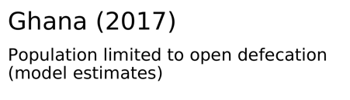
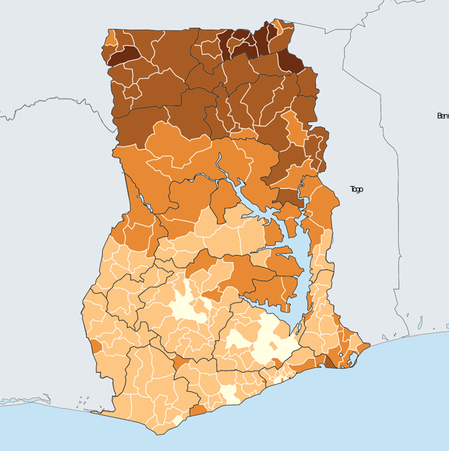
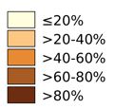
Why use small area estimation?
Need: identify areas of focus or needing attention based on socioeconomic indicators.
Context in LMICs: infrequency of census data to use for direct estimation, combined with increasing occurrence of large scale surveys (DHS, MICS)
Notes:
-

Slide 4
Methods of SAE
Direct estimation
Area-based models
Unit-based models
Notes:
-

Slide 5
Methods of SAE
How do we know when to use which method?
Depends on:
What we are trying to estimate.
Survey design.
Auxiliary information available.
Evaluation of estimates:
Bias – how much does the estimate represent the survey design?
Coefficient of variation (CV)
Accuracy – how close are the estimates to the true value of the population parameter?
Mean squared error
Notes:
-

Slide 6
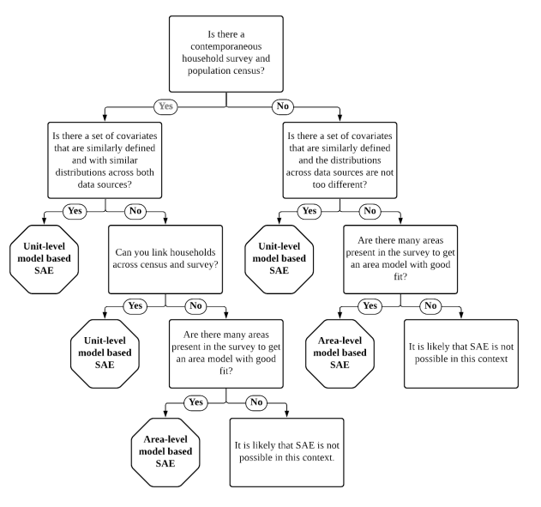
SAE Decision Tree
Notes:
-

Slide 7
Direct Estimation
Direct estimation: taking a sample from the target universe of observations, surveying that sample, then using standard statistical techniques to generalize the results to the entire population.
Can only be used when the survey design has taken into account estimation for the level of analysis desired.
Coeficient of variation (CV) can be used to determine if sample sizes are “sufficiently large.”
Typically used by default due to desirable properties with respect to the sampling design.
Notes:
-

Slide 8
Direct Estimation
Horvitz-Thompson (HT) Estimator: to estimate the total of an area or domain, it is equal to the sum of the weights multiplied by the outcome variable. To estimate the mean of an area or domain, it is equal to the sume of the weights multiplied by the outcome variable divided by the population of the domain.
Hajek Estimator: similar to HT, but uses the sampling weights for the considered area to estimate the population of the domain. May increase bias, but removes need for knowing the population size of small domains.
Notes:
-

Slide 9
Direct Estimation
Requirements of Direct Estimation:
Notes:
-

Slide 10
Direct Estimation
Advantages:
Non-parametric – no assumptions have to be made.
Unbiased according to sampling design.
Consistency.
Can be benchmarked using additivity
Disadvantages:
Inefficient for small areas.
Direct estimates cannot be calculated for non-sampled domains.
Notes:
- • They make no model assumptions (non-parametric).
• HT is exactly unbiased under the sampling design for large areas. Hájek and GREG estimators
are approximately unbiased under the sampling design for large areas.
• It is an unbiased estimator under the sampling design if the expected value (mean) of the
estimator across all the possible samples sd drawn from area d with the given design is equal to
the population parameter. In other words, if its design bias is equal to zero for all the values of
the parameter. The estimator ˆθd of parameter θ is unbiased if and only if Eπ(
ˆθd) − θd = 0.
• Consistency: as the sample size increases, the probability that the estimator ˆθ differs from the true value θ by more than ε approximates 0, for every ε > 0.
• Additivity (Benchmarking property): Sum(D d=1) Yˆd = Yˆ , that is, the direct estimate of the total for a larger area covering several areas coincides with the aggregation of the estimates of the totals for the areas within the larger area.
• Inefficient for small areas. For an area d with small nd, traditional area-specific direct estimators do not provide adequate precision.

Slide 11
Live DEMO

Slide 12
Area Level Models
Fey Herriot Model: estimating the distribution of the target area-level poverty indicator, given a set of area-level covariates based on two models:
A sampling model for direct area estimates of poverty.
A linking model where the true indicator is linearly related to a vector of auxiliary variables across all areas.
Combination of direct and synthetic estimates.
Regression model to produce synthetic estimates typically uses random effects.
Unlike unit-level models, auxiliary data such as census or administrative records are not required. Variables from these sources can be used though.
Notes:
-

Slide 13
Area Level Models
Sampling model: using direct estimates such as those produced using Horvitz-Thompson or Hajek estimation.
Linking model: regression model with random effects on region/area using maximum likelihood (ML) or restricted maximum likelihood (REML).
Variable selection:
Stepwise pattern – advised to remove all non-significant variables.
Test for multicollinearity – remove variables with high Variance Inflation Factor (VIF > 5).
Combining results: Empirical Best Linear Unbiased Predictor (EBLUP) – weighted average between the direct estimator and the regression-synthetic estimator.
Weight is largely determined by sample size of small area – small areas with larger sample sizes will assign greater weight to the direct estimates and vice versa.
Notes:
-

Slide 14
Area Level Models
Step by step process:
Compute direct estimates.
Write out bias (CV) and accuracy (MSE) metrics.
Run initial linking model.
Remove non-significant variables.
Check VIF. Remove variables with high multicollinearity.
Rerun model. Remove non-significant variables again if any remain.
Produce fitted estimates to create synthetic estimates.
Write out bias and accuracy metrics (CV and MSE).
Combine direct and synthetic estimates to produce final SAE estimates.
Notes:
-

Slide 15
Area Level Models
Advantages:
Improve accuracy/efficiency (MSE).
Incorporates unexplained heterogeneity between areas.
Incorporates direct estimation where sample size is sufficient.
Consistent with sampling design.
Less affected by outliers and can produce estimates for areas not sampled
Not computationally demanding.
Unlike unit-level models, does not require covariates that match auxiliary data.
Notes:
-

Slide 16
Area Level Models
Disadvantages:
Model based estimates need to be checked.
Model is fit only on sampled areas.
Bias vs. accuracy trade-offs.
Prasad-Rao MSE estimator is approximately unbiased under the model with normality but is not design unbiased for a given area.
Notes:
-

Slide 17
Live DEMO

Slide 18
Unit Level Models
Direct estimation:
Notes:
-

Slide 19
Unit Level Models
Empirical Best (EB) or Elbers, Lanjou and Lanjouw (ELL) model: relying on estimating the distribution of the outcome variable using a set of covariates common in both the survey dataset and a largerauxiliary dataset (typically the population census).
Unit level models allow us to “borrow strength” by incorporating information from other areas, measured variables, and datasets.
Need to have a survey and auxiliary data (i.e. census).
Model requirements:
Ideally from similar years.
A set of variables in survey that are related to outcome variable.
Census must contain same variables in survey except for outcome variable.
Location variable (small areas) must use same identification in both survey and census to properly link together.
Notes:
-

Slide 20
Unit Level Models
Decision process
Potential covariates need to be examined thoroughly in both survey and census.
Variable may be common in both but response options or categories may differ (i.e. an education variable may have different levels of schooling).
Check on survey weights to understand how they are constructed.
Model selection:
Restricted maximum likelihood (REML) or generalized least squares (GLS).
Specifying random effects at level of small areas (i.e. district) or level below (i.e. cluster)?
If the latter, a two-fold nested error model with cluster effected nested within area effects can be used.
Depends on level of variance of both levels.
Notes:
- Important to check the mean and standard deviation on any variable used in both datasets to see if there are any notable differences. Ideally, the mean and distribution of the covariates should be comparable, at least at the aggregation level at which the survey is designed to be representative.

Slide 21
Unit Level Models
Model selection (cont.):
REML model – does not incorporate survey weights nor heteroskedasticity.
Uses Monte Carlo simulation to produce point estimates.
Can be used for one-fold or two-fold error nested models.
Henderson’s III GLS model – allows for inclusion of heteroskedasticity and survey weights.
Can only be used for one-fold models.
Alpha Test to determine which model has a better fit.
Notes:
- Important to check the mean and standard deviation on any variable used in both datasets to see if there are any notable differences. Ideally, the mean and distribution of the covariates should be comparable, at least at the aggregation level at which the survey is designed to be representative.

Slide 22
Unit Based Models
Once model selection is complete, we can focus on which covariates to include.
Should only be those that are statistically significant among those initially chosen (similar to Fey Herriot Model).
Make any data transformations to variables to include.
Simulation stage
Import census data (only necessary variables named same as in survey).
Produce point estimates through Monte Carlo simulation.
Recommended number of simulations: at least 100.
Estimation of MSE.
Recommended at least 200 bootsrap replications to estimate MSE.

Slide 23
Unit Level Models
Advantages:
Model is based on household-level data, which gives greater detailed information.
Can provide estimates for non-sampled areas.
Optimal – minimize MSE under the model.
Estimates are unbiased if model is true and parameters are known.
Can get estimates at any level of aggregates.
Notes:
-

Slide 24
Unit Level Models
Disadvantages:
Can produce noisy estimates and may be worse than direct estimates if heterogeneity between areas is not explained.
Need to check model after producing estimates.
Bootstrap methods for MSE estimation is computationally intensive.
EB estimates do not consider sampling design and are not design unbiased.
Notes:
-

Slide 25
Live DEMO

Slide 26
Additional Materials
Examples highlighting Ghana:
District-level Estimates of Institutional Births in Ghana: Application of Small Area Estimation Technique Using Census and DHS Data (uow.edu.au)
Model-Based Small Area Estimation of Regional-Level Maternal Mortality Prevalence in Ghana (degruyter.com)
Estimating unmet need for contraception by district within Ghana: An application of small-area estimation techniques: Population Studies: Vol 66 , No 2 - Get Access (tandfonline.com)

Slide 27
Additional Materials
Supplemental guide:
Asian Development Bank Guide to SAE (in R)- https://www.adb.org/sites/default/files/publication/609476/small-area-estimation-guide-nsos.pdf
Spatial-Temporal Smoothing SAE in R
How-to with DHS - https://zehangli.com/Subnational/RSession-2.html
Article: https://journals.plos.org/plosone/article?id=10.1371/journal.pone.0210645
Multilevel Regressions with Post-stratification (MRP)
Overview - https://www.intechopen.com/online-first/1117715
Applications - https://tellingstorieswithdata.com/15-mrp.html
MRP Case Studies - https://bookdown.org/jl5522/MRP-case-studies/
Use of Geospatial Covariates:
Spatial Modeling for Subnational Administrative Level 2 Small-Area Estimation (English)

Slide 28
Additional Materials

Slide 29
Thank You!
XXXXXXXXXXXXXX
XXXXXXXXXXX
XXXXXXXXXXX@icf.com

Slide 30











U.S. Government Partners
Notes:
Please include this slide in your presentation in the appropriate location. Notes: Feed the Future connects U.S. Government efforts targeted at global hunger and food security. Led by USAID, Feed the Future draws on the resources and expertise of the U.S. Departments of Agriculture, Commerce, State and Treasury; the Millennium Challenge Corporation; the United States African Development Foundation; the Peace Corps; the Overseas Private Investment Corporation; the Office of the United States Trade Representative; and the U.S. Geological Survey.

